Slide 1
Introduction to Machine Learning
Shevchik Sergey, Giulio Masinelli, Patrik Hoffmann

Slide 2

What’s Machine Learning?
Machine Learning (def 1): an ensemble of techniques aiming at approximating a functional that represents a probability distribution.
Machine Learning (def 2, Tom Mitchell 1998): A computer program is said to learn from experience E with respect to some class of tasks T and performance measure P, if its performance at tasks in T, as measured by P, improves with experience E.
Practically, it is the discipline that is concerned with the design and development of algorithms that allow computers to learn from data.
Examples: Autonomously learn to recognize complex patterns and make intelligent decisions based on data
Example: Computers learning from medical records which treatments are most effective for new diseases
Materials processing with intelligent systems (MICRO-457) Shevchik S., Masinelli G. & Hoffmann P.

Slide 3
What’s Machine Learning?
Example
  Task T: Detecting diseases from biomedical signals
  Training Experience E: Learning from signals labelled by an expert
  Performance Measure P: Compare how well the algorithm is performing compared to an expert on unseen new signals
Materials processing with intelligent systems (MICRO-457) Shevchik S., Masinelli G. & Hoffmann P.

Slide 4
What’s Machine Learning?
With respect to the mechanism used for training, it is divided into 3 main categories:
  Supervised Learning: learning from example input-output pairs – this lecture.
  Unsupervised Learning: pure data-driven process: discovering patterns in a dataset, e.g., clustering.
  Reinforcement Learning: learning how to interact in an environment by looking at the impact every action has on the environment itself.
Materials processing with intelligent systems (MICRO-457) Shevchik S., Masinelli G. & Hoffmann P.

Slide 5
Supervised Learning – example 1
We are given a bunch of examples couple, hours of study vs mark.
Our goal is to predict the mark for a new student, given his hours of study.
This is a regression problem.
Regression problem: the prediction is a (or multiple) real-valued number(s) (as in this case).
Materials processing with intelligent systems (MICRO-457) Shevchik S., Masinelli G. & Hoffmann P.
Notes:
A simple algo, will try to fit a line. Maybe it will be better to fit a quadratic function (second order polynomial)

Slide 6
Supervised Learning – example 2
We want to evaluate if a bridge needs maintenance given his age.
This is a classification problem.
Classification: the prediction is discrete-valued output (either 0 or 1, in this case).
Materials processing with intelligent systems (MICRO-457) Shevchik S., Masinelli G. & Hoffmann P.

Slide 7
Supervised Learning – example 2 (con’t)
To get a better classification, we can introduce additional information about the bridge, such as its length.
In this case, we say that every input data has two features (length and age, in this case).
Materials processing with intelligent systems (MICRO-457) Shevchik S., Masinelli G. & Hoffmann P.

Slide 8
Unsupervised Learning – example
An unsupervised learning algorithm, is an algorithm that is purely data driven: it is not given with the correct answers and has to learn from those, but it has to discover the data similarities by itself.
Materials processing with intelligent systems (MICRO-457) Shevchik S., Masinelli G. & Hoffmann P.

Slide 9

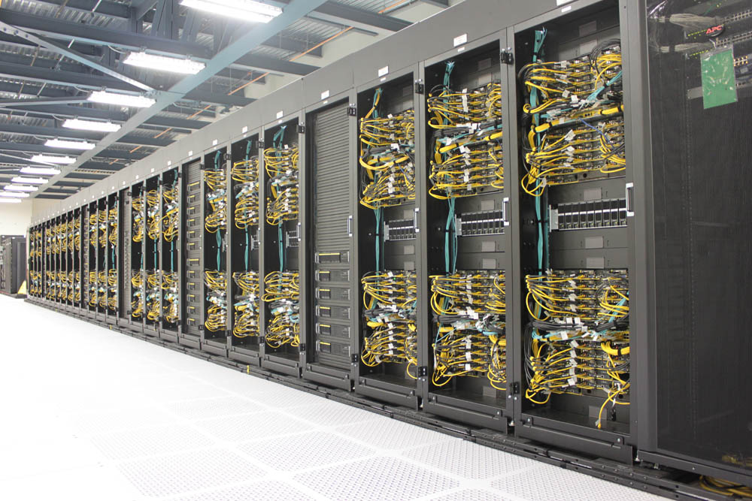
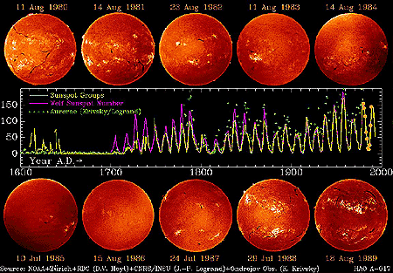
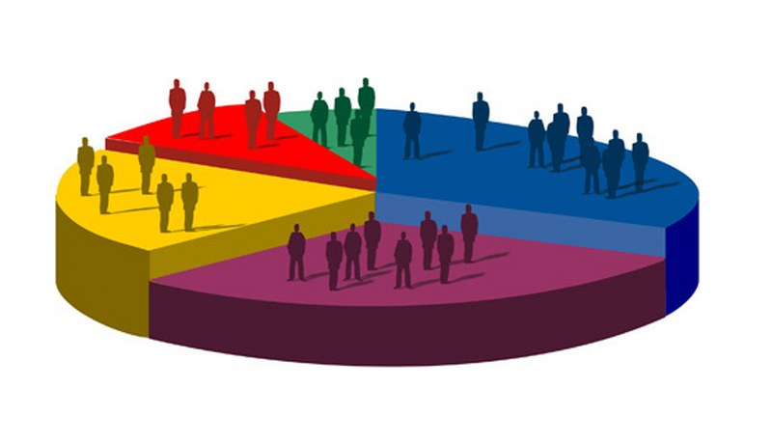
Unsupervised Learning – examples
Organizing computing clusters
Social network analysis
Market Segmentation
Astronomical data analysis
Materials processing with intelligent systems (MICRO-457) Shevchik S., Masinelli G. & Hoffmann P.

Slide 10
Supervised learning – univariate linear regression
Marks vs the number of hours of study
Supervised learning: learning from example input-output pairs.
We gave the “right answer” for every example data
Materials processing with intelligent systems (MICRO-457) Shevchik S., Masinelli G. & Hoffmann P.

Slide 11
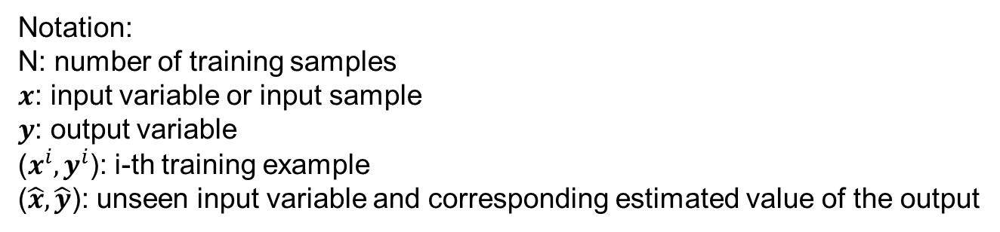
Supervised learning – univariate linear regression
Training set:
Hour of study (x) | Mark (y)
5.2 | 3.4
6.1 | 4.3
7 | 5.1
8 | 4.9
… | …
Notation:
N: number of training samples
$x$: input variable or input sample
$y$: output variable
($x^{i},y^{i}$): i-th training example
($\hat{x},\hat{y}$): unseen input variable and corresponding estimated value of the output
Materials processing with intelligent systems (MICRO-457) Shevchik S., Masinelli G. & Hoffmann P.

Slide 12
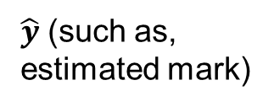
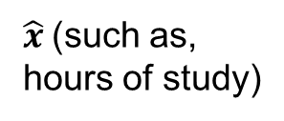
Supervised learning – univariate linear regression
Training set
Learning Algorithm
h
(decision rule or hypothesis)
$\hat{x}$(such as,
hours of study)
$\hat{y}$ (such as,
estimated mark)
h, the decision rule, that has been “trained” on the training set ($x^{i},y^{i}$) for $i=1, 2, …, N$, maps the unseen input sample $\hat{x}$to $\hat{y}$.
Materials processing with intelligent systems (MICRO-457) Shevchik S., Masinelli G. & Hoffmann P.

Slide 13


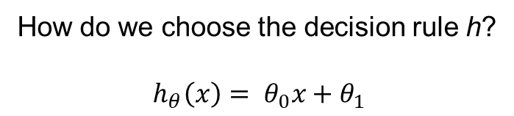
Supervised learning – univariate linear regression
How do we choose the decision rule h?
$$h_{θ}\left(x\right)= θ_{0}x+θ_{1}$$
Training set
Learning Algorithm
h
(decision rule or hypothesis)
$$\hat{x}$$
$$\hat{y}$$
This is generally referred to as univariate linear regression or linear regression with a single variable
Materials processing with intelligent systems (MICRO-457) Shevchik S., Masinelli G. & Hoffmann P.

Slide 14
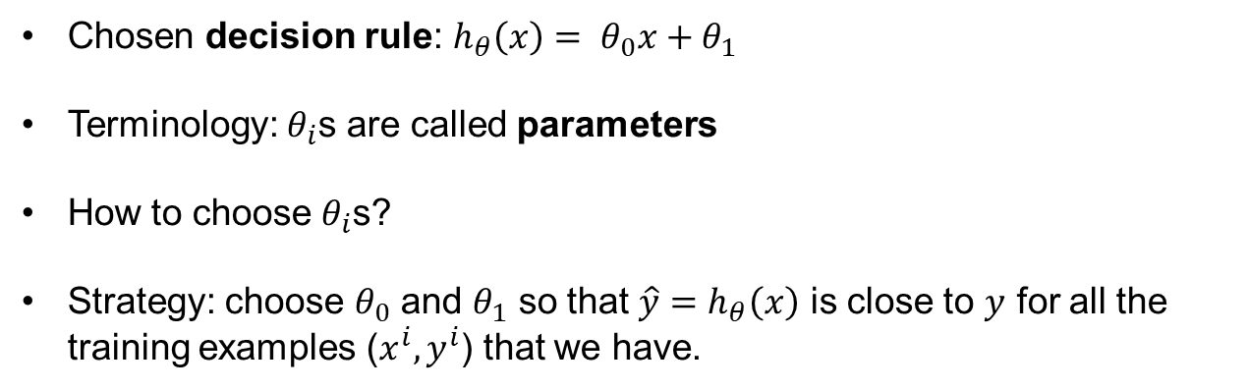
Univariate linear regression – cost function
Training set:
Hour of study (x) | Mark (y)
5.2 | 3.4
6.1 | 4.3
7 | 5.1
8 | 2.1
… | …
Chosen decision rule: $h_{θ}\left(x\right)= θ_{0}x+θ_{1}$
Terminology: $θ_{i}$s are called parameters
How to choose $θ_{i}$s?
Strategy: choose $θ_{0}$ and $θ_{1}$ so that ${\hat{y}=h}_{θ}\left(x\right)$ is close to $y$ for all the training examples ($x^{i},y^{i}$) that we have.
Materials processing with intelligent systems (MICRO-457) Shevchik S., Masinelli G. & Hoffmann P.

Slide 15
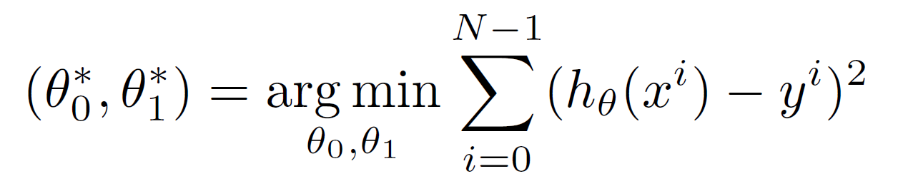
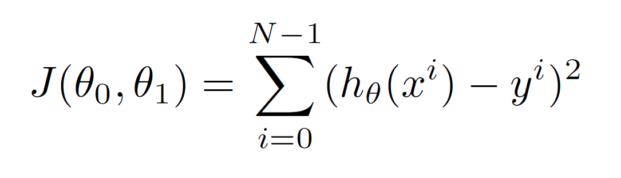
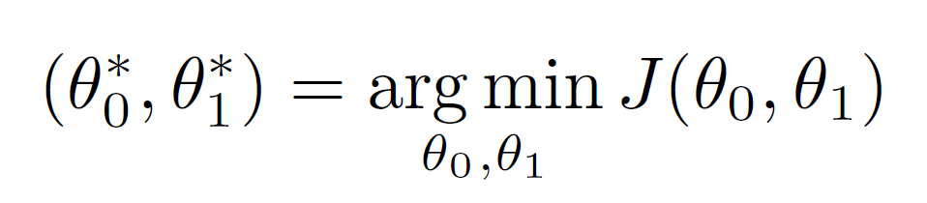
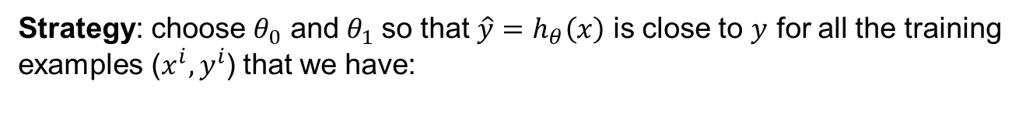
Univariate linear regression – cost function
Strategy: choose $θ_{0}$ and $θ_{1}$so that ${\hat{y}=h}_{θ}\left(x\right)$ is close to $y$ for all the training examples ($x^{i},y^{i}$) that we have:
The function that we are minimizing is generally indicated by $J(θ_{0},θ_{1})$, and it’s called cost function:
So, our problem can be written as the minimization of the cost function:
Materials processing with intelligent systems (MICRO-457) Shevchik S., Masinelli G. & Hoffmann P.
Notes:
To be precise, this cost function is called squared error function

Slide 16
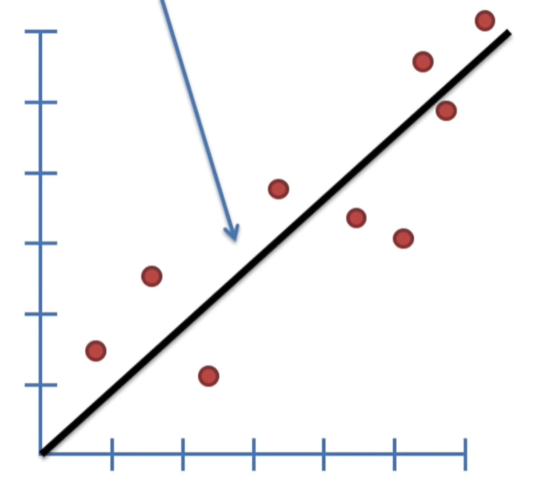
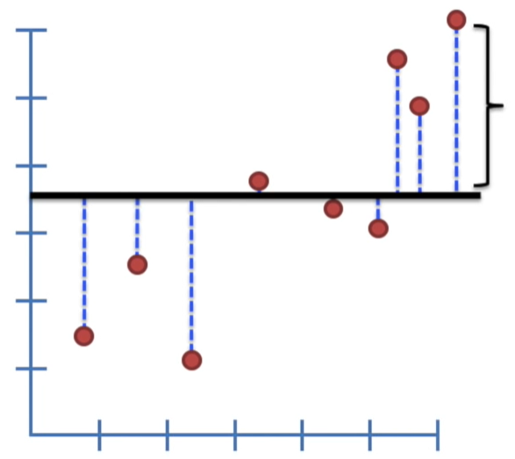
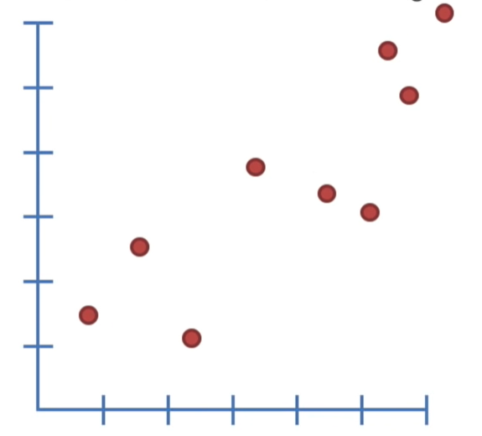
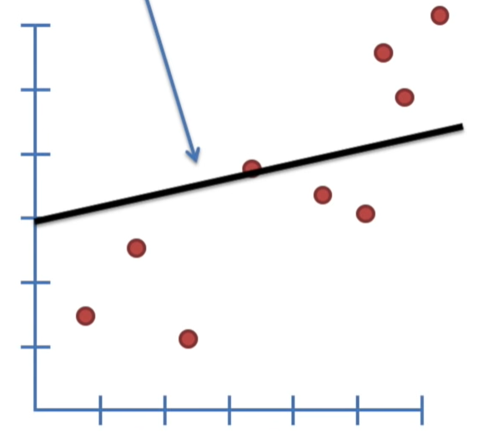
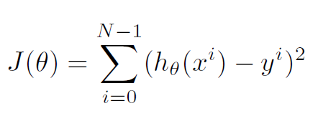
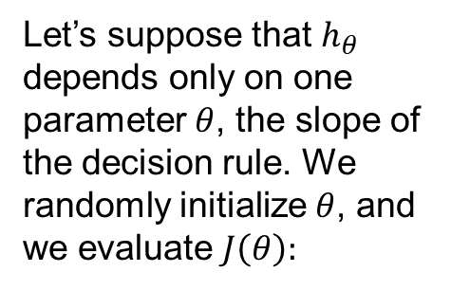

Univariate linear regression – cost function
Intuition
Let’s suppose that $h_{θ}$ depends only on one parameter $θ$, the slope of the decision rule. We randomly initialize $θ$, and we evaluate $J\left(θ\right):$
y
We modify $θ$, and we evaluate $J\left(θ_{new}\right).$
x
Materials processing with intelligent systems (MICRO-457) Shevchik S., Masinelli G. & Hoffmann P.
Notes:
To be precise, this cost function is called squared error function

Slide 17
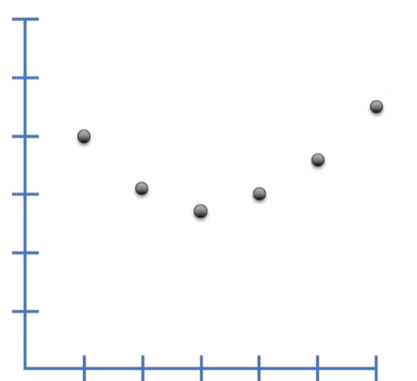


Univariate linear regression – cost function
Intuition
We end up with a plot like this for $J(θ$):
$$J\left(θ\right)$$
$$θ$$
Materials processing with intelligent systems (MICRO-457) Shevchik S., Masinelli G. & Hoffmann P.
Notes:
To be precise, this cost function is called squared error function

Slide 18
Univariate linear regression – cost function
Intuition
What if the cost function depends on two parameters $J(θ_{0},θ_{1})$?
Materials processing with intelligent systems (MICRO-457) Shevchik S., Masinelli G. & Hoffmann P.
Notes:
To be precise, this cost function is called squared error function

Slide 19
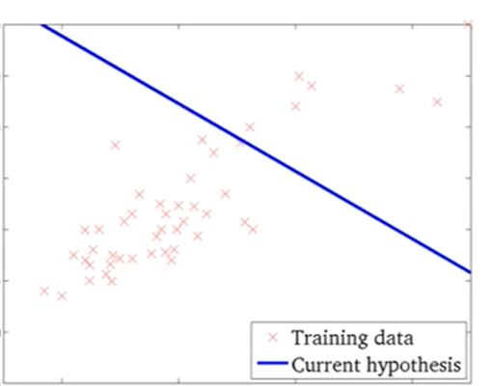
Univariate linear regression – cost function
Intuition
What if the cost function depends on two parameters $J(θ_{0},θ_{1})$?
Materials processing with intelligent systems (MICRO-457) Shevchik S., Masinelli G. & Hoffmann P.

Slide 20
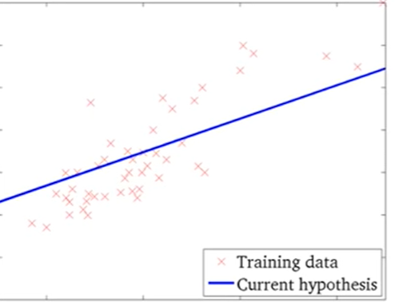
Univariate linear regression – cost function
Intuition
What if the cost function depends on two parameters $J(θ_{0},θ_{1})$?
Materials processing with intelligent systems (MICRO-457) Shevchik S., Masinelli G. & Hoffmann P.
Notes:
To be precise, this cost function is called squared error function

Slide 21
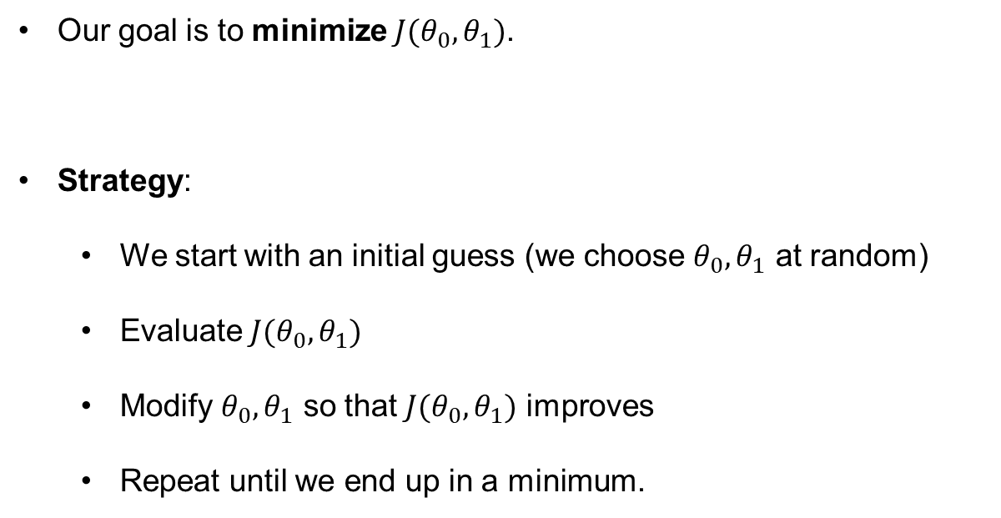
Gradient descend – outline
Our goal is to minimize $J(θ_{0},θ_{1})$.
Strategy:
  We start with an initial guess (we choose $θ_{0},θ_{1}$ at random)
  Evaluate $J(θ_{0},θ_{1})$
  Modify $θ_{0},θ_{1}$ so that $J(θ_{0},θ_{1})$ improves
  Repeat until we end up in a minimum.
Materials processing with intelligent systems (MICRO-457) Shevchik S., Masinelli G. & Hoffmann P.
Notes:
To be precise, this cost function is called squared error function

Slide 22
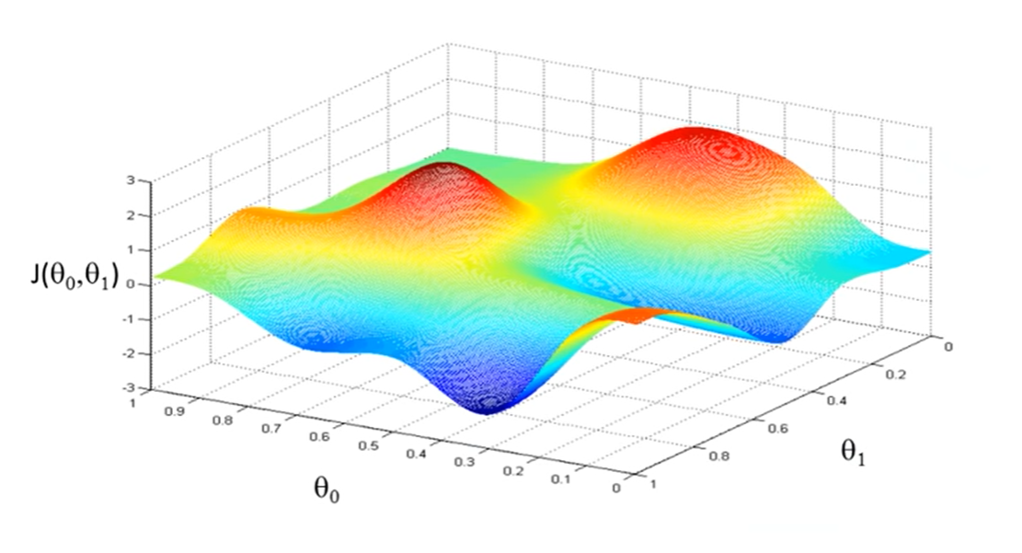
Gradient descend – intuition
Our goal is to minimize $J(θ_{0},θ_{1})$.
Every time, we move in the direction of the steepest descent
Materials processing with intelligent systems (MICRO-457) Shevchik S., Masinelli G. & Hoffmann P.

Slide 23
Gradient descend – intuition
Our goal is to minimize $J(θ_{0},θ_{1})$.
Notice that if you start from a different location, you can end up in a completely different ending point!
Materials processing with intelligent systems (MICRO-457) Shevchik S., Masinelli G. & Hoffmann P.
Notes:
To be precise, this cost function is called squared error function

Slide 24
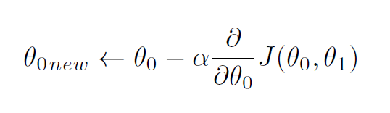
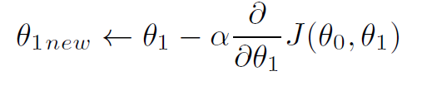
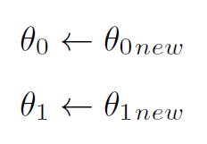

Gradient descend – algorithm
Algorithm:
  We start with an initial guess (we choose $θ_{0}, θ_{1}$ at random)
  Evaluate $\frac{∂}{∂θ_{0}}J\left(θ_{0},θ_{1}\right)$ and $\frac{∂}{∂θ_{1}}J\left(θ_{0},θ_{1}\right)$
  Update $θ_{0},θ_{1}$ in this way:
  Repeat until convergence.
Learning rate or learning
step
Materials processing with intelligent systems (MICRO-457) Shevchik S., Masinelli G. & Hoffmann P.
Notes:
The arrow is the assignment operator. Set left hand side to be equal to right hand side
The learning rate control how big is the step that each time we are taking toward the direction were J has its steepest descent.
Note that the update of theta 0 and theta 1 is simultaneous (first you compute all the derivatives, and then, you update the parameters). If you update one after the other, you’re not doing grad descend (if you do 1, 3, 2, 4).

Slide 25
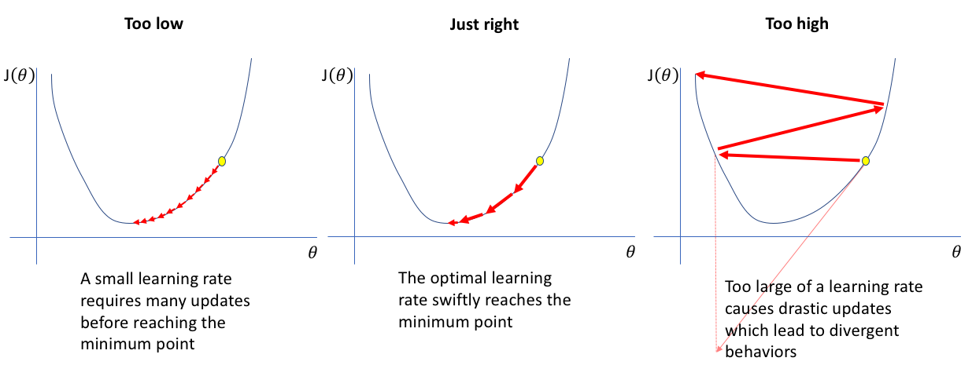
Gradient descend – learning rate
How to chose the learning rate
For simplicity, let’s suppose the cost function only depends from one parameter
Too small
Correct learning rate
Too big
If the learning rate is too small, too many updates are required before reaching the minimum
If the learning rate is correct, in few steps, we smoothly reach the minimum
If the learning rate too big, we can overshoot the target, or even diverge
Materials processing with intelligent systems (MICRO-457) Shevchik S., Masinelli G. & Hoffmann P.
Notes:
As we know from calculus, the derivative represents the slope of the tangent to the plot at the point we are considering.
It can be seen as the direction where the function has its maximum increment. In this univariate case, the direction can only be left or right.
The direction of the increment here is right, so we move in the opposite direction (remind the minus).

Slide 26
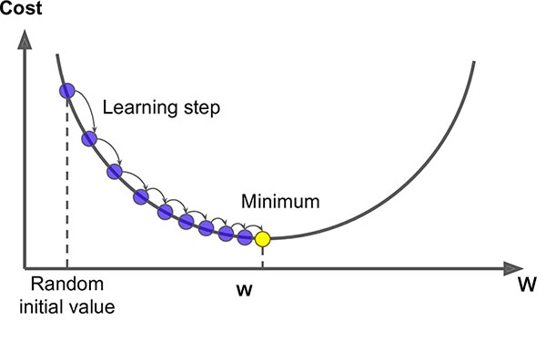
Gradient descend – learning rate
Notice that as we get closer to the minimum, the gradient will naturally become smaller and smaller, as the function tends to flatten out.
Thus, with a correct choice of the learning rate, we should converge without overshooting.
Materials processing with intelligent systems (MICRO-457) Shevchik S., Masinelli G. & Hoffmann P.
Notes:
We know that at the local minimum, the derivative is 0.

Slide 27

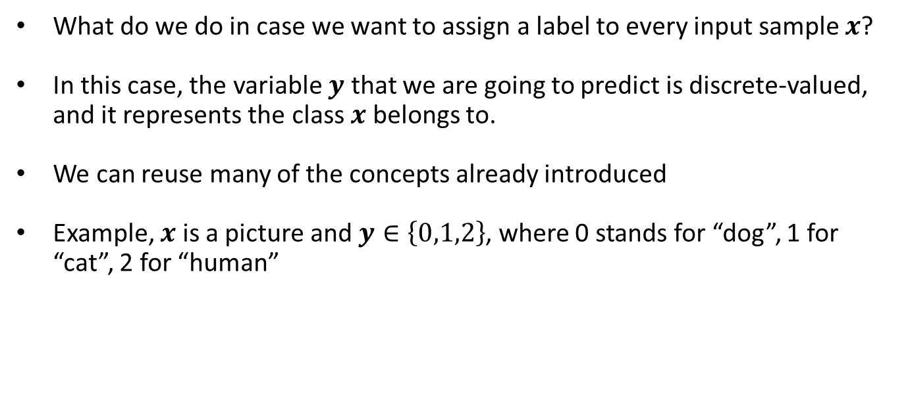

Supervised learning – classification problems
What do we do in case we want to assign a label to every input sample $x$?
In this case, the variable $y$ that we are going to predict is discrete-valued, and it represents the class $x$ belongs to.
We can reuse many of the concepts already introduced
Example, $x$ is a picture and $y∈\left\{0,1,2\right\}$, where 0 stands for “dog”, 1 for “cat”, 2 for “human”
$$y=1$$
Materials processing with intelligent systems (MICRO-457) Shevchik S., Masinelli G. & Hoffmann P.
Notes:
The assignment of the classes is of course arbitrary. It doe not really matter for the algorighm. Anyways, in a binary problem (with two classes), the class 0 is often related to the absence of something (such as, no need for maintenance), while 1 is related to the presence of something. In this case, 0 is called the negative class, while 1 is the negative one.

Slide 28
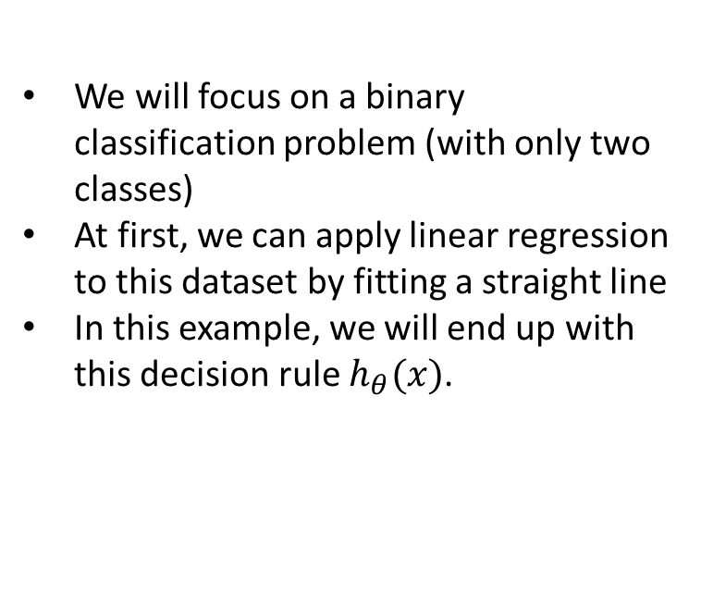

Classification problems – linear regression
We will focus on a binary classification problem (with only two classes)
At first, we can apply linear regression to this dataset by fitting a straight line
In this example, we will end up with this decision rule $h_{θ}(x)$.
One solution is to insert a threshold to output of the regression.
If $h_{θ}\left(x\right)≥th$, predict 1
If $h_{θ}\left(x\right)<th$, predict 0
Materials processing with intelligent systems (MICRO-457) Shevchik S., Masinelli G. & Hoffmann P.
Notes:
So we are predicting, everything to the right of this point as class 1 and everything to the left as class 0.
So it’s look like we can simply cast the regression algorithm for the classification purposes

Slide 29
Classification problems – linear regression
Let’s now add a new data sample, belonging to class 1.
Again, we fit a straight line
Now, if we fix the threshold at 0.5 as we did before, we get plenty of misclassifications!
Applying linear regression to a classification problem is often not a good idea
Materials processing with intelligent systems (MICRO-457) Shevchik S., Masinelli G. & Hoffmann P.
Notes:
Notice that the new data sample is totally legit, and – using the same decision rule we have seen before – we would have classified it correctly.

Slide 30
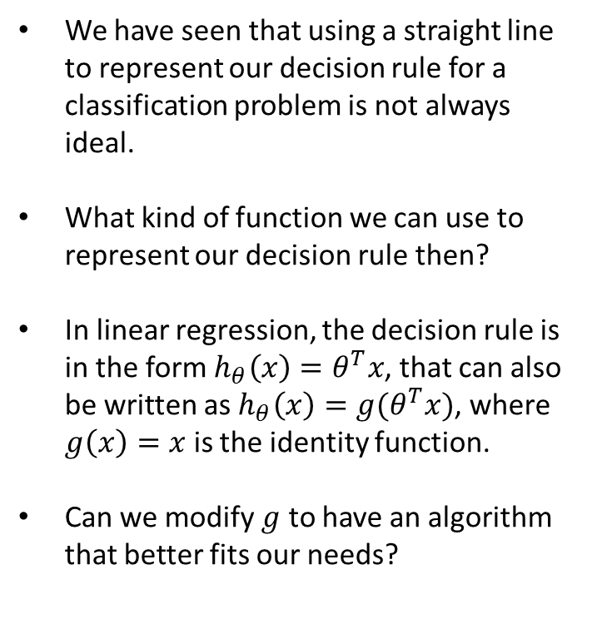
Classification problems – logistic regression
We have seen that using a straight line to represent our decision rule for a classification problem is not always ideal.
What kind of function we can use to represent our decision rule then?
In linear regression, the decision rule is in the form $h_{θ}\left(x\right)=θ^{T}x$, that can also be written as $h_{θ}\left(x\right)=g(θ^{T}x)$, where $g\left(x\right)=x$ is the identity function.
Can we modify $g$ to have an algorithm that better fits our needs?
Materials processing with intelligent systems (MICRO-457) Shevchik S., Masinelli G. & Hoffmann P.
Notes:
Notice that the new data sample is totally legit, and – using the same decision rule we have seen before – we would have classified it correctly.

Slide 31
Classification problems – logistic regression
Let’s consider the following example:
In this, there is no decision rule that would produce no misclassifications.
In this case, we cannot find a decision rule that works all the time. What we can do is to find one that works most of the time.
We need to take a probabilistic approach.
Materials processing with intelligent systems (MICRO-457) Shevchik S., Masinelli G. & Hoffmann P.
Notes:
Notice that the new data sample is totally legit, and – using the same decision rule we have seen before – we would have classified it correctly.

Slide 32
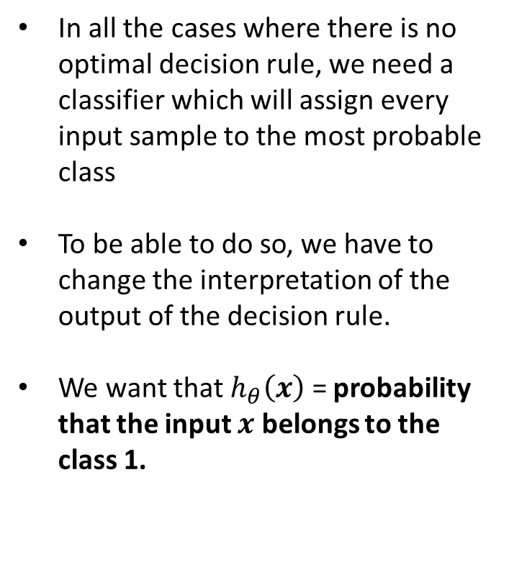
Classification problems – logistic regression
In all the cases where there is no optimal decision rule, we need a classifier which will assign every input sample to the most probable class
To be able to do so, we have to change the interpretation of the output of the decision rule.
We want that $h_{θ}\left(x\right)$ = probability that the input $x$ belongs to the class 1.
Materials processing with intelligent systems (MICRO-457) Shevchik S., Masinelli G. & Hoffmann P.
Notes:
In practice, we always use a probabilistic classifier to address every real-life problem.

Slide 33
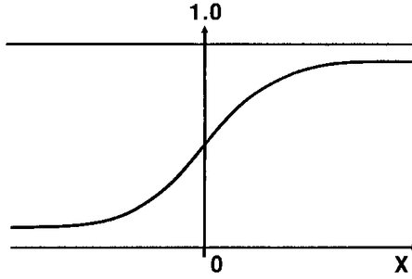
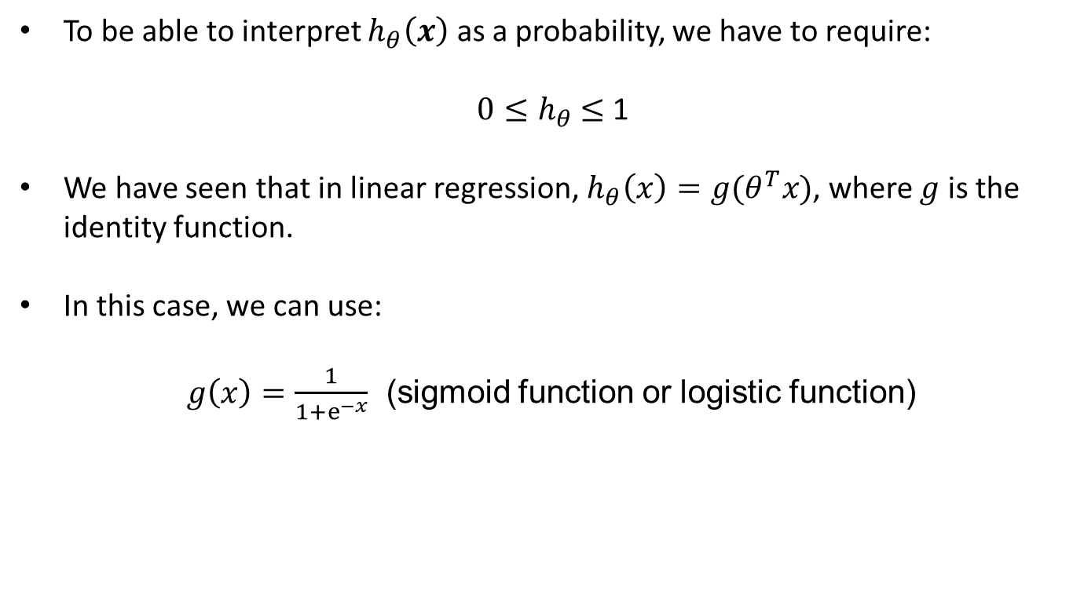
Classification problems – logistic regression
To be able to interpret $h_{θ}\left(x\right)$ as a probability, we have to require:
$0≤h_{θ}$ $≤$ 1
We have seen that in linear regression, $h_{θ}\left(x\right)=g(θ^{T}x)$, where $g$ is the identity function.
In this case, we can use:
  $g\left(x\right)=\frac{1}{1+ⅇ^{−x}}$ (sigmoid function or logistic function)
Materials processing with intelligent systems (MICRO-457) Shevchik S., Masinelli G. & Hoffmann P.
Notes:
Notice that the sigmoid has an asymptote at 1 and an asymptote at 0 and its values are always between 0 and 1.

Slide 34
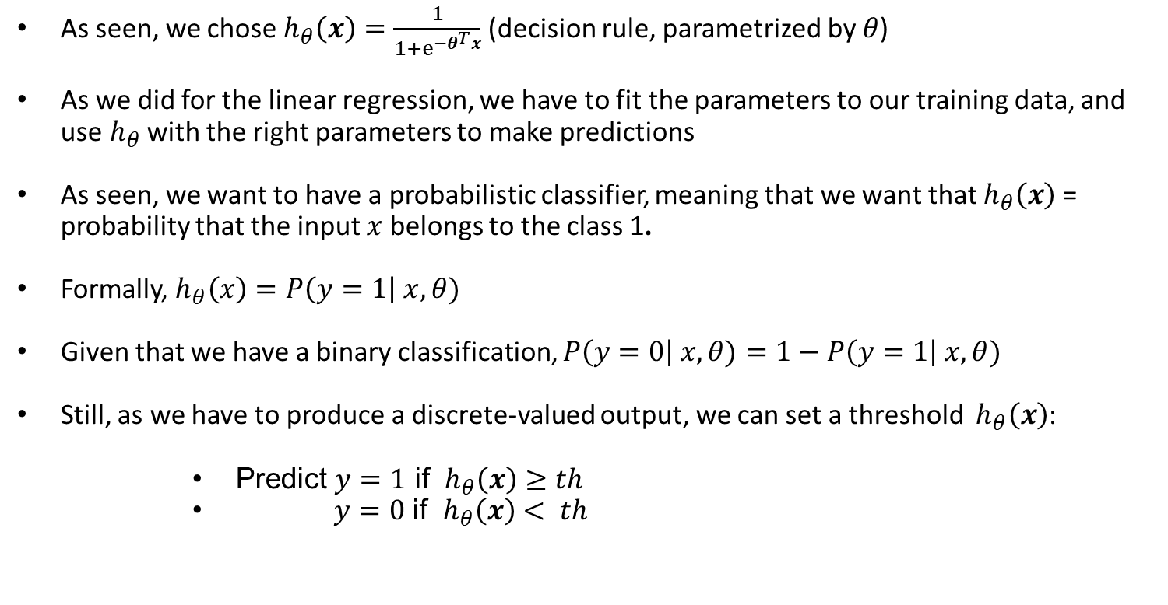
Classification problems – logistic regression
As seen, we chose${ h}_{θ}\left(x\right)=\frac{1}{1+ⅇ^{−θ^{T}x}}$ (decision rule, parametrized by $θ$)
As we did for the linear regression, we have to fit the parameters to our training data, and use${ h}_{θ}$ with the right parameters to make predictions
As seen, we want to have a probabilistic classifier, meaning that we want that $h_{θ}\left(x\right)$ = probability that the input $x$ belongs to the class 1.
Formally, $h_{θ}\left(x\right)=P\left(y=1\right| x, θ)$
Given that we have a binary classification, $P\left(y=0\right| x, θ)=1−P\left(y=1\right| x, θ)$
Still, as we have to produce a discrete-valued output, we can set a threshold ${ h}_{θ}\left(x\right)$:
      Predict $y=1$ if ${ h}_{θ}\left(x\right)$ $≥th$
              $y=0$ if ${ h}_{θ}\left(x\right)< th$
Materials processing with intelligent systems (MICRO-457) Shevchik S., Masinelli G. & Hoffmann P.
Notes:
It’s the sum rule. Indeed, y must be either 1 or zero. So the probability of having either 1, or 0 (that is the sum of the two probabilities) has to be equal to 1.
Notice that h of x being greater than a threshold (0.5), means that it is more likely to have y = 1 than y = 0, given the sample that we are considering

Slide 35

Logistic regression – intuition
What does${ h}_{θ}\left(x\right)$ $≥th$imply?
Let’s fix $th$ to 0.5.
As seen, the sigmoid is monotonically increasing, and:
              $g\left(x\right) ≥0.5 ⇔x≥$ 0
Since $h_{θ}\left(x\right)=g(θ^{T}x)$, $h_{θ}\left(x\right)$ $≥0.5 ⇔θ^{T}x≥$ 0
Similarly, $h_{θ}\left(x\right)$ $<0.5 ⇔θ^{T}x<$ 0
Materials processing with intelligent systems (MICRO-457) Shevchik S., Masinelli G. & Hoffmann P.
Notes:
So, our decision rule is going to predict either 0 or 1 whenever theta transpose x is greater or equal than 0

Slide 36

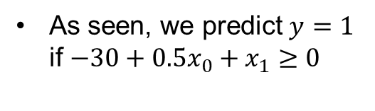
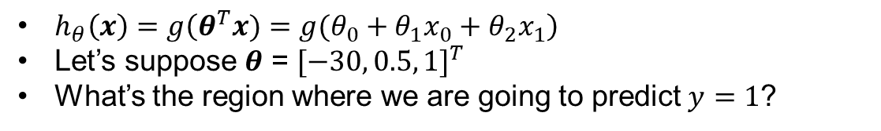
Logistic regression – intuition (con’t)
$h_{θ}\left(x\right)=g\left(θ^{T}x)=g(θ_{0}+θ_{1}x_{0}+θ_{2}x_{1}\right)$
Let’s suppose $θ$ = ${[−30, 0.5, 1]}^{T}$
What’s the region where we are going to predict $y=1$?
As seen, we predict $y=1$ if $−30+0.5x_{0}+x_{1}$ $≥0$
$$x_{1}=−0.5x_{0}+30$$
The blue line is often called the
decision boundary
Materials processing with intelligent systems (MICRO-457) Shevchik S., Masinelli G. & Hoffmann P.
Notes:
So, for any sample that satisfy this inequality, we predict that it belongs to class 1.
Let’s see where the equality holds. It is the blue line. The part of the space where this amount is positive, is above the line.
So, the blue line represents all the points where h(x) is exactly 0.5
The decision boundary separates the points where the classifier predicts one, and those where it predicts 0.
Notice that the decision boundary depends on the decision rule and on its parameters. Its shape is chosen a priori, not depending on the data. According to the data we have, we can only modify the params

Slide 37
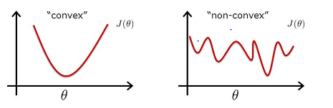
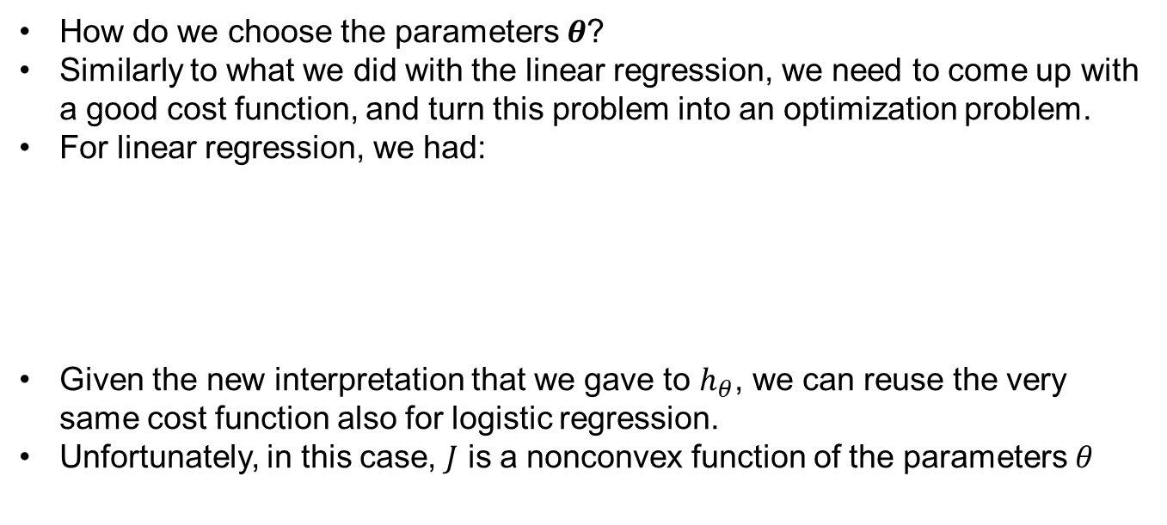
Logistic regression – cost function
How do we choose the parameters $θ$?
Similarly to what we did with the linear regression, we need to come up with a good cost function, and turn this problem into an optimization problem.
For linear regression, we had:
Given the new interpretation that we gave to $h_{θ}$, we can reuse the very same cost function also for logistic regression.
Unfortunately, in this case, $J$ is a nonconvex function of the parameters $θ$
Materials processing with intelligent systems (MICRO-457) Shevchik S., Masinelli G. & Hoffmann P.
Notes:
The cost has to be intended as the “punishment” the algorithm gets for outputting h of x given that the real outcome was y.
This is due to the nonlinear nature of the sigmoid function that has an exponential. So this cost function, that apparently is the same as the one used before, become more complex.

Slide 38
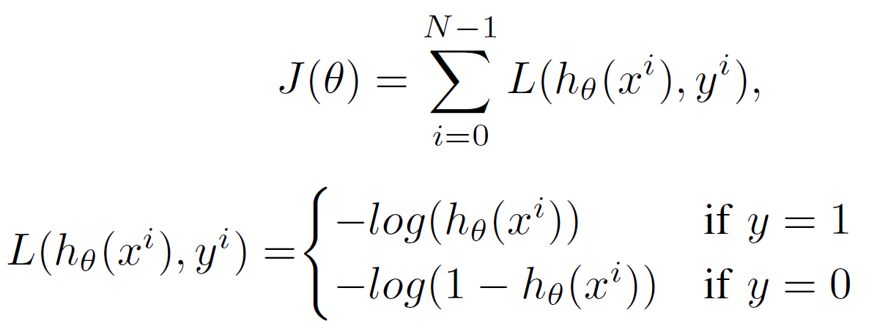
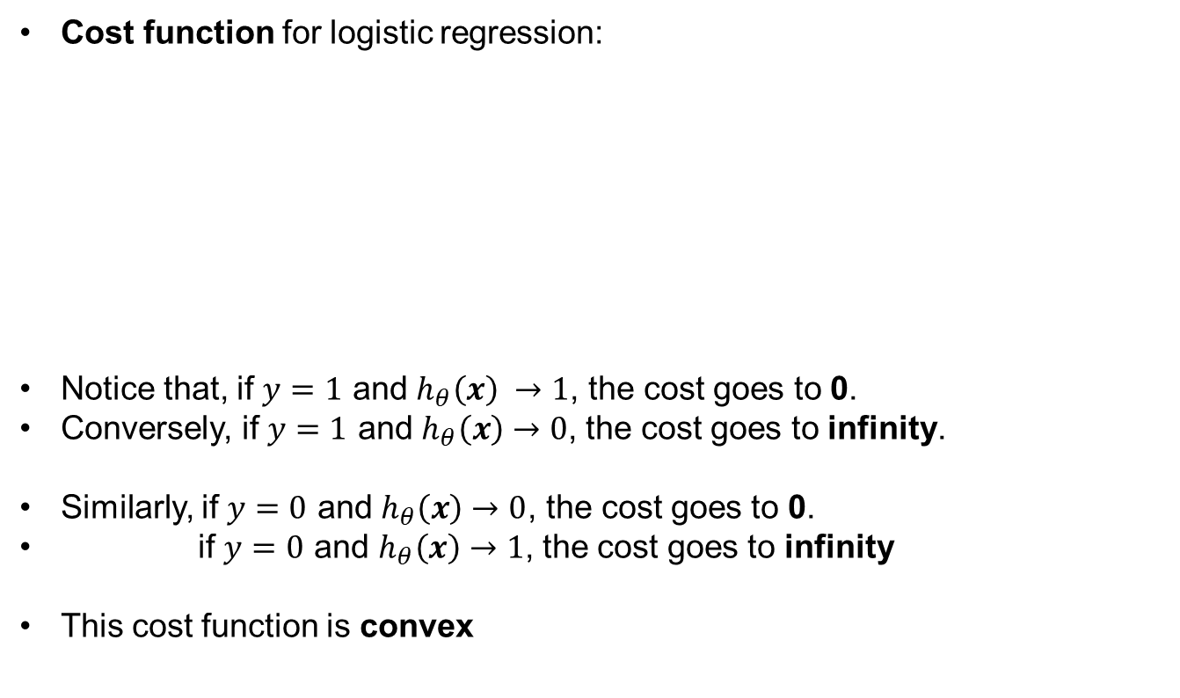
Logistic regression – cost function
Cost function for logistic regression:
Notice that, if $y=1$ and $h_{θ}\left(x\right) →1$, the cost goes to 0.
Conversely, if $y=1$ and $h_{θ}\left(x\right)$ $→0$, the cost goes to infinity.
Similarly, if $y=0$ and $h_{θ}\left(x\right)→0$, the cost goes to 0.
if $y=0$ and $h_{θ}\left(x\right)$ $→1$, the cost goes to infinity
This cost function is convex
Materials processing with intelligent systems (MICRO-457) Shevchik S., Masinelli G. & Hoffmann P.

Slide 39
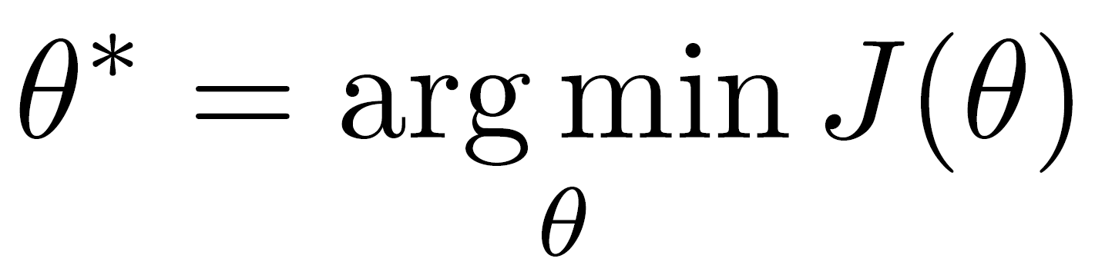
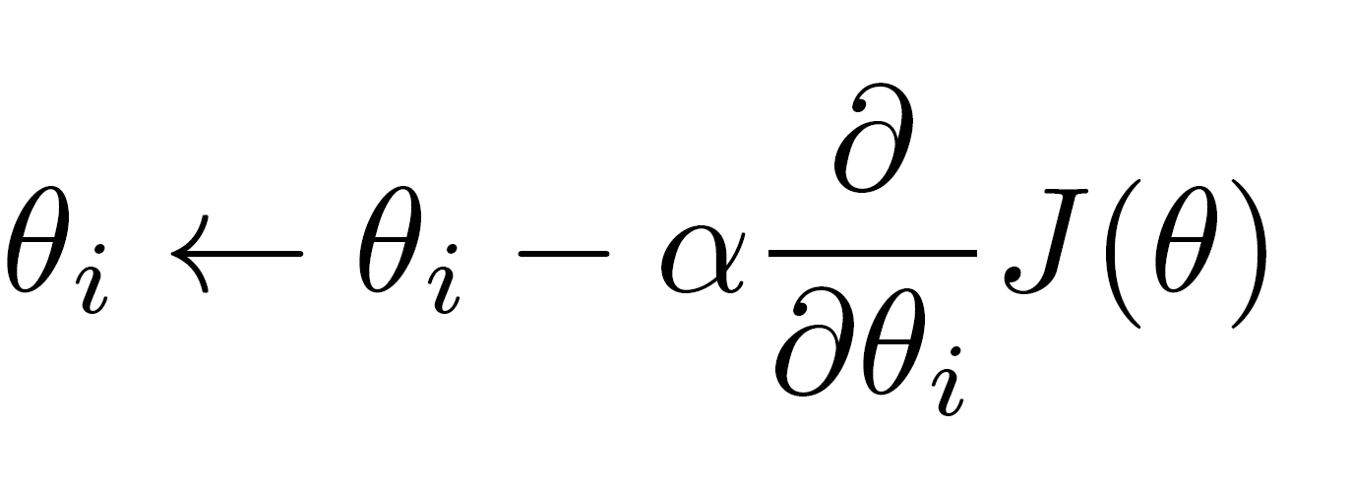


Logistic regression – recap
As we did for the linear regression, to fit the parameters $θ$, we have to solve:
To do this operation, we use gradient descend:
Finally, given a new sample $\hat{x}$, we compute:
$${ h}_{θ}\left(\hat{x}\right)=\frac{1}{1+ⅇ^{−{θ^{∗}}^{T}\hat{x}}}$$
Using simultaneous updates for all $θ_{i}$s
Materials processing with intelligent systems (MICRO-457) Shevchik S., Masinelli G. & Hoffmann P.
Notes:
Notice that this algorithm looks almost identical to linear regression. What is truly different, in logistic regression, is the definition of the hypotheses h of x. In linear regression, h of x was just theta transpose x, but here, it is more complex

Slide 40
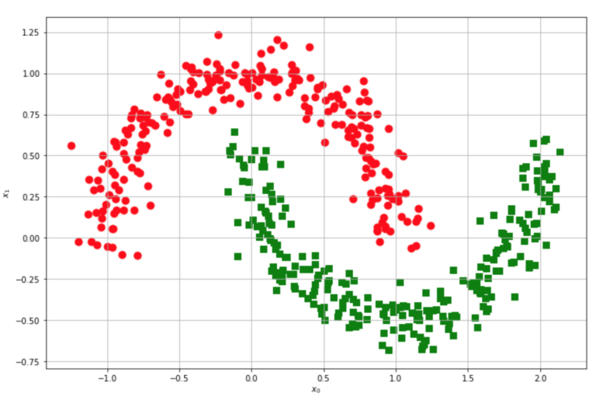
Neural Networks – motivations
Logistic Regression is a very simple, yet powerful, technique – but it has some limitations.
Let’s consider the following classification problem:
In this case, the two classes aren’t linearly separable. We can’t use logistic regression.
We need to come out with a nonlinear decision rule.
Materials processing with intelligent systems (MICRO-457) Shevchik S., Masinelli G. & Hoffmann P.
Notes:
Neural Networks are state of the art techniques for many classification and regression problems

Slide 41


Neural Networks – motivations
So far, we have seen examples where the input sample for represented by 1 or 2 features.
Many interesting applications, though, can have more than 1k features
In those cases, it is very likely that the data isn’t linearly separable.
Example: classifying images (computer vision).
For the classifier, this image is a tensor 3 (as the RGB channels) x 1200 (pixels on the x-axes) x 650 (pixels on the y-axes): it is represented by 2’340’000 8-bit values!
In this case, the feature vector $x= \left[\begin{matrix}\begin{matrix}intensity of pixel 1 \\ intensity of pixel 2\end{matrix} \\ \begin{matrix}… \\ intensity of pixel 2^{′}{340}^{′}000\end{matrix}\end{matrix}\right]∈ℝ^{23400000}$
Materials processing with intelligent systems (MICRO-457) Shevchik S., Masinelli G. & Hoffmann P.
Notes:
Simple logistic regression is generally not a good way to learn complex nonlinear decision rules. Neural Networks turn out to be a much better way to learn complex nonlinear decision rules, even when the input feature space is very large

Slide 42
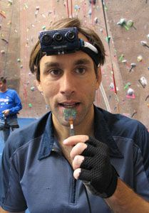
Neural Networks – background
Neural Networks (NN) are considered state-of-the-art techniques for a big variety of applications
Originally designed to have algorithms that can mimic the brain
The brain, indeed, can process a huge amount of data, from different outputs, and can learn locomotor skills, multiple languages, recognize complex patterns… with a single learning algorithm!
          There are devices that allow to see with the tongue: the intensity of each pixel of the greyscale camera produces a different tension to different locations in the tongue
Danilov, Yuri & Tyler, Mitchell. (2006).
Brainport: An alternative input to the brain.
Journal of integrative neuroscience. 4. 537-50.
Materials processing with intelligent systems (MICRO-457) Shevchik S., Masinelli G. & Hoffmann P.
Notes:
They were designed in the 80s and become very popular. They have been almost abandoned in the 90s when people realize that to make these algos work, the networks become computationally very expensive.
Only recently, in the late 90s with the developments of GPU and very powerful machines, the NN have been rediscovered.
Why mimicking the brain? The brain is amazing.
To prove this hypothesis of having a single learning algorithm, scientist have rerouted the nerve that connects the auditory cortex to the ear and connected it to the optical nerve (neural rewire experiments). The animal learned to see with the auditory cortex! It was able to perform visual discrimination of food and whatsoever.
This means that the same piece of brain tissue can process sight, or touch and all the other sense – making the brain a single learning algo
So the idea of NN is to mimic the brain so that we can have an algorithm that can process whatever kind of data and does the same things the brain does

Slide 43

Neural Networks – background (con’t)
NN were designed using as networks of neurons, using a simplified mathematical model of the neurons in the brain.
The neuron is seen as a computational unit that gets several inputs from the dendrites, does some computations, and sends signals via the axons to other neurons.
: Input “wires” that receive inputs from other locations
: Output “wires” that send messages to other neurons
Materials processing with intelligent systems (MICRO-457) Shevchik S., Masinelli G. & Hoffmann P.
Notes:
At first approximation, the brains works as network of neurons that receive input data and sends out some information to other multiple neurons that, in turn, send info to other neurons, and so on
A neural network closely reproduce this concept

Slide 44




Neural Networks – mathematical model
The logistic unit, the mathematical model of an artificial neuron.
Every artificial neuron, performs the following computation:
where
Artificial neuron with a sigmoid activation function (the function $g$)
Materials processing with intelligent systems (MICRO-457) Shevchik S., Masinelli G. & Hoffmann P.
Notes:
The parameters theta of the NN are often called weights

Slide 45

Neural Networks – mathematical model
A Neural Network is a collection of artificial neurons, connected together.
The networks are organized in layers. The first one is called the input layer, the final layer is called the output layer.
All the layers in between are called hidden layers
Materials processing with intelligent systems (MICRO-457) Shevchik S., Masinelli G. & Hoffmann P.
Notes:
These are called hidden layers simply because you don’t observe hem during training. You can see the input, can see the output (and penalize the network in case the output is wrong, as did before), but we don’t have direct access to the input layer (it is not x, nor y).

Slide 46





Neural Networks – mathematical model
Let’s track all the computations happening there!
Notation:
${a_{i}}^{(j)}=$activation of the i-th unit in layer j
${\text{Θ}}^{(j)}$= matrix of all the weights of layer j
Example: ${\text{Θ}}^{(2)}=\left[\begin{matrix}θ_{1}^{1} & θ_{1}^{2} & θ_{1}^{3} \\ θ_{2}^{1} & θ_{2}^{2} & θ_{2}^{3} \\ θ_{3}^{1} & θ_{3}^{2} & θ_{3}^{3}\end{matrix}\right]$
Materials processing with intelligent systems (MICRO-457) Shevchik S., Masinelli G. & Hoffmann P.
Notes:
Take home message: here we see how the picture at the top defines a NN which is a function h that maps from the input space where xs live to a probability.
Notice that now, the decision rule h is parametrized by capital theta that is a collection of matrices (a tensor).

Slide 47


Neural Networks – mathematical model
Let’s track all the computations happening there!
Notation:
${a_{i}}^{(j)}=$activation of the i-th unit in layer j
${\text{Θ}}^{(j)}$= matrix of all the weights of layer j
Example: ${\text{Θ}}^{(2)}=\left[\begin{matrix}θ_{1}^{1} & θ_{1}^{2} & θ_{1}^{3} \\ θ_{2}^{1} & θ_{2}^{2} & θ_{2}^{3} \\ θ_{3}^{1} & θ_{3}^{2} & θ_{3}^{3}\end{matrix}\right]$
Materials processing with intelligent systems (MICRO-457) Shevchik S., Masinelli G. & Hoffmann P.
Notes:
Take home message: here we see how the picture at the top defines a NN which is a function h that maps from the input space where xs live to a probability.
Notice that now, the decision rule h is parametrized by capital theta that is a collection of matrices (a tensor).

Slide 48


Neural Networks – mathematical model
Let’s track all the computations happening there!
Notation:
${a_{i}}^{(j)}=$activation of the i-th unit in layer j
${\text{Θ}}^{(j)}$= matrix of all the weights of layer j
Example: ${\text{Θ}}^{(2)}=\left[\begin{matrix}θ_{1}^{1} & θ_{1}^{2} & θ_{1}^{3} \\ θ_{2}^{1} & θ_{2}^{2} & θ_{2}^{3} \\ θ_{3}^{1} & θ_{3}^{2} & θ_{3}^{3}\end{matrix}\right]$
If the network has several hidden layers, if the layer k has $q_{k}$units, and layer k+1 has $q_{k+1}$units, then ${\text{Θ}}^{(k+1)}∈ℝ^{q_{k+1}× q_{k}}$
Materials processing with intelligent systems (MICRO-457) Shevchik S., Masinelli G. & Hoffmann P.
Notes:
The process of computing h(x) from x is generally called forward pass, or forward propagation, as we propagate the info from the input to the hidden layer, to the output layer.
Given the ability of the new hardware to speed up vectorized operations, this new way of writing it down makes it very fast to compute

Slide 49

Neural Networks – intuition
What is the NN doing? Can it learn nonlinear decision rules?
We have seen that the main building block of a Neural Network is the logistic unit:
But this is just logistic regression!
Materials processing with intelligent systems (MICRO-457) Shevchik S., Masinelli G. & Hoffmann P.

Slide 50
Neural Networks – intuition
Even going “forward” in the NN, we only find logistic regressions:
Materials processing with intelligent systems (MICRO-457) Shevchik S., Masinelli G. & Hoffmann P.

Slide 51

Neural Networks – intuition
Even going “forward” in the NN, we only find logistic regressions:
If we only focus on this part of the NN, we see that this is a logic regression, but not using as input the features $x_{1},x_{2},x_{3}$, but new features ${a_{1}^{(2)}a_{2}^{(2)}a_{3}^{(2)}}^{}$, computed by the previous layer, as function of the input
Materials processing with intelligent systems (MICRO-457) Shevchik S., Masinelli G. & Hoffmann P.
Notes:
Concretely, the NN is not constrained to feed the input features x to the logistic regression, but it can learn its own features and then feed those to logistic regression !
This is why you can end up with a way better decision rule than using logistic regression: you can learn really good features, useful for classification in the hidden layers!
The algorithm has the liberty to extract the features he wants from the input

Slide 52

Neural Networks – architectures
The structure of a NN is not necessarily fixed: depending on how we connect the neurons and how many of them we use, we can have different architectures:
Materials processing with intelligent systems (MICRO-457) Shevchik S., Masinelli G. & Hoffmann P.
Notes:
The idea of going “deeper” is that we can give the network the liberty to extract important features in the first hidden layer, then it can combine those in the second hidden layer to create even more complex features, and again combine those in the third hidden layer and so on
Describe figure B in terms of how many hidden layers and how many units

Slide 53



Neural Networks – Examples
Let’s consider the following problem:
This problem is evidently linearly separable, so we can use the logistic regression
$$b$$
$$x_{1}$$
-30
20
$$x_{2}$$
20
20
Materials processing with intelligent systems (MICRO-457) Shevchik S., Masinelli G. & Hoffmann P.

Slide 54




Neural Networks – Examples
20
$$b$$
$$x_{1}$$ | $$x_{2}$$ | $$h_{θ}(x)$$
0 | 0 | $$g\left(−30\right)≅0$$
0 | 1 | $$g\left(−10\right)≅0$$
1 | 0 | $$g\left(−10\right)≅0$$
1 | 1 | $$g\left(10\right)≅1$$
$$x_{1}$$
-30
20
$$x_{2}$$
20
Materials processing with intelligent systems (MICRO-457) Shevchik S., Masinelli G. & Hoffmann P.

Slide 55




Neural Networks – Examples
Similarly, if we have a problem like this:
And we use the following weights:
We get:
$$b$$
$$x_{1}$$
20
-10
$$x_{2}$$
20
$$x_{1}$$ | $$x_{2}$$ | $$h_{θ}(x)$$
0 | 0 | $$g\left(−10\right)≅0$$
0 | 1 | $$g\left(10\right)≅1$$
1 | 0 | $$g\left(10\right)≅1$$
1 | 1 | $$g\left(30\right)≅1$$
Materials processing with intelligent systems (MICRO-457) Shevchik S., Masinelli G. & Hoffmann P.

Slide 56

Neural Networks – Examples
Again, if we have a problem like this:
And we use the following weights:
We get:
$$b$$
$$x_{1}$$
-20
10
$$x_{2}$$
-20
$$x_{1}$$ | $$x_{2}$$ | $$h_{θ}(x)$$
0 | 0 | $g\left(10\right) ≅$ 1
0 | 1 | $$g\left(−10\right)≅0$$
1 | 0 | $$g\left(−10\right)≅0$$
1 | 1 | $$g\left(−30\right)≅0$$
Materials processing with intelligent systems (MICRO-457) Shevchik S., Masinelli G. & Hoffmann P.

Slide 57










Neural Networks – Examples
What if we have a problem like this?
This case is not linearly separable
Let’s use a Neural Network
We have seen that:
$$b$$
$$x_{1}$$
20
-30
$$x_{2}$$
+20
$$b$$
1w1w
$$b$$
20
-30
$$x_{1}$$
$$b$$
$$x_{1}$$ | $$x_{2}$$ |  |  | $$h_{θ}(x)$$
0 | 0 | 0 | 1 | 1
0 | 1 | $$0$$ | 0 | 0
1 | 0 | $$0$$ | 0 | 0
1 | 1 | $$1$$ | 0 | 1
$$x_{1}$$
20
-10
$$a_{1}^{(2)}$$
-20
20
-10
$$x_{2}$$
20
20
$$a_{2}^{(2)}$$
20
$$b$$
$$x_{2}$$
-20
$$x_{1}$$
-20
10
10
$$x_{2}$$
-20
$$b$$
Materials processing with intelligent systems (MICRO-457) Shevchik S., Masinelli G. & Hoffmann P.

Slide 58

Neural Network – cost function
Cost function:
Notice that, if $y=1$ and $h_{θ}\left(x\right) →1$, the cost goes to 0.
Conversely, if $y=1$ and $h_{θ}\left(x\right)$ $→0$, the cost goes to infinity.
Similarly, if $y=0$ and $h_{θ}\left(x\right)→0$, the cost goes to 0.
if $y=0$ and $h_{θ}\left(x\right)$ $→1$, the cost goes to infinity
Materials processing with intelligent systems (MICRO-457) Shevchik S., Masinelli G. & Hoffmann P.

Slide 59

Neural Network – recap
As we did for the logistic regression, to fit the parameters $θ$, we have to solve:
To do this operation, we use gradient descend:
Finally, given a new sample $\hat{x}$, we compute:
Using simultaneous updates for all $θ_{i}$s
Materials processing with intelligent systems (MICRO-457) Shevchik S., Masinelli G. & Hoffmann P.
Notes:
Notice that this algorithm looks almost identical to linear regression. What is truly different, in logistic regression, is the definition of the hypotheses h of x. In linear regression, h of x was just theta transpose x, but here, it is more complex

Slide 60
Content
Supervised learning
An example of supervised learning: Deep Learning
Deep Learning is a subset of ML and it is mainly based on learning representations of data. It turns out to be really effective in learning patterns.
It uses learning algorithms that derive meaning out of data by using a hierarchy of multiple layers.
In particular, a Deep Neural Network consists of a hierarchy of layers where each of them transforms the input data into a more abstract representation.
Materials processing with intelligent systems (MICRO-457) Shevchik S., Masinelli G. & Hoffmann P.

Slide 61

Content
Supervised learning
In this case, the abstract representation of the data learned ranges from edges, through facial features (nose, eyes, lips…), to faces.
Image from Visual Detection, Recognition and Tracking with Deep Learning, Yu Huang, VP of Technology, Autonomous Driving Research
Materials processing with intelligent systems (MICRO-457) Shevchik S., Masinelli G. & Hoffmann P.

